Slide 1
Pennsylvania Association of
Community Health Centers
2016 Meeting & Legislative Day
May 17, 2016
Leesa Allen
Deputy Secretary
Office of Medical Assistance Programs

Slide 2
Medicaid Expansion
Agenda
Medicaid Expansion
Provider Revalidation and Enrollment
Shared Space SOP and Attestation
HealthChoices Procurement
Partnering with Community Health Centers
On the Horizon
Notes:
As of the most recent data pull per Dan Mink.

Slide 3
Medicaid Expansion
Pennsylvania Celebrates One-year Anniversary of Medicaid Expansion
More than 630,000 Pennsylvanians now have access to high-quality health care services
Notes:
As of the most recent data pull per Dan Mink.

Slide 4
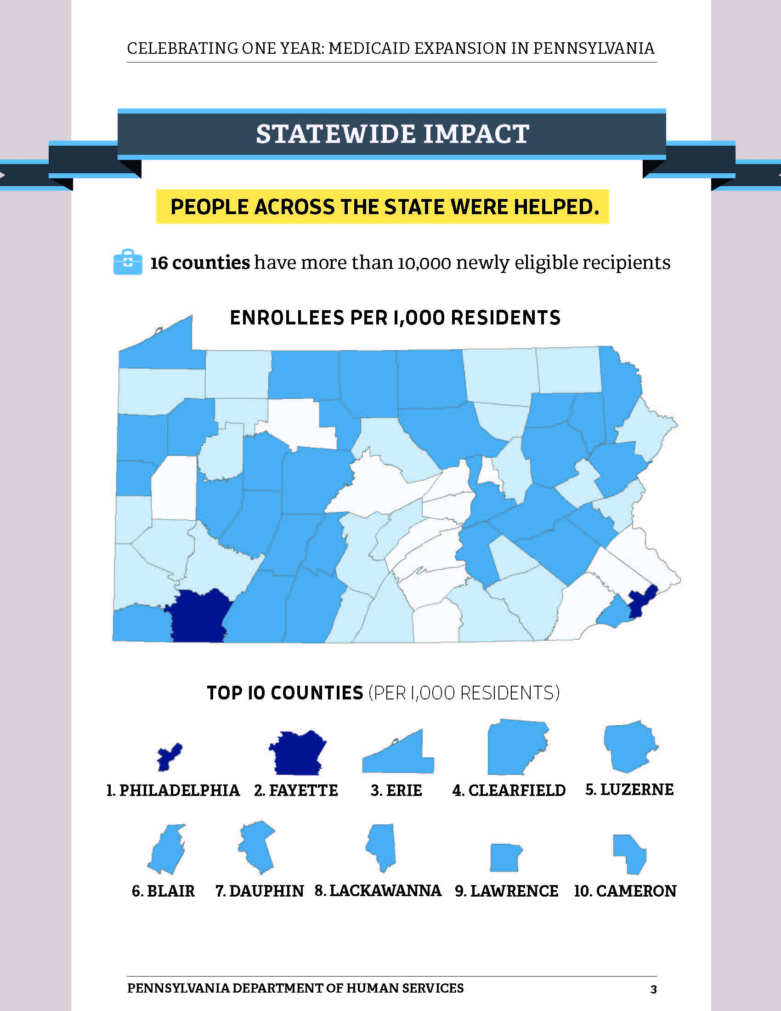
Medicaid Expansion
3
10
8
9
4
5
6
7
2
1
Notes:
Statewide Impact
People across the state were helped
16 counties that have more than 10,000 newly eligible recipients are:
Allegheny
Berks
Bucks
Chester
Dauphin
Delaware
Erie
Lackawanna
Lancaster
Lehigh
Luzerne
Montgomery
Northampton
Philadelphia
Westmoreland
York
Not highlighted on the map
The statewide impact map is a heat map that shows the number of enrollees per 1,000 residents, by county.
Darker means more people per 1000 -
Over all counties benefited and some counties with low population levels had very high numbers of enrollees per 1000
The top 10 counties with new enrollees per 1,000 residents are:
Philadelphia, Fayette, Erie, Clearfield, Luzerne, Blair, Dauphin, Lackawanna, Lawrence, and Cameron.

Slide 5
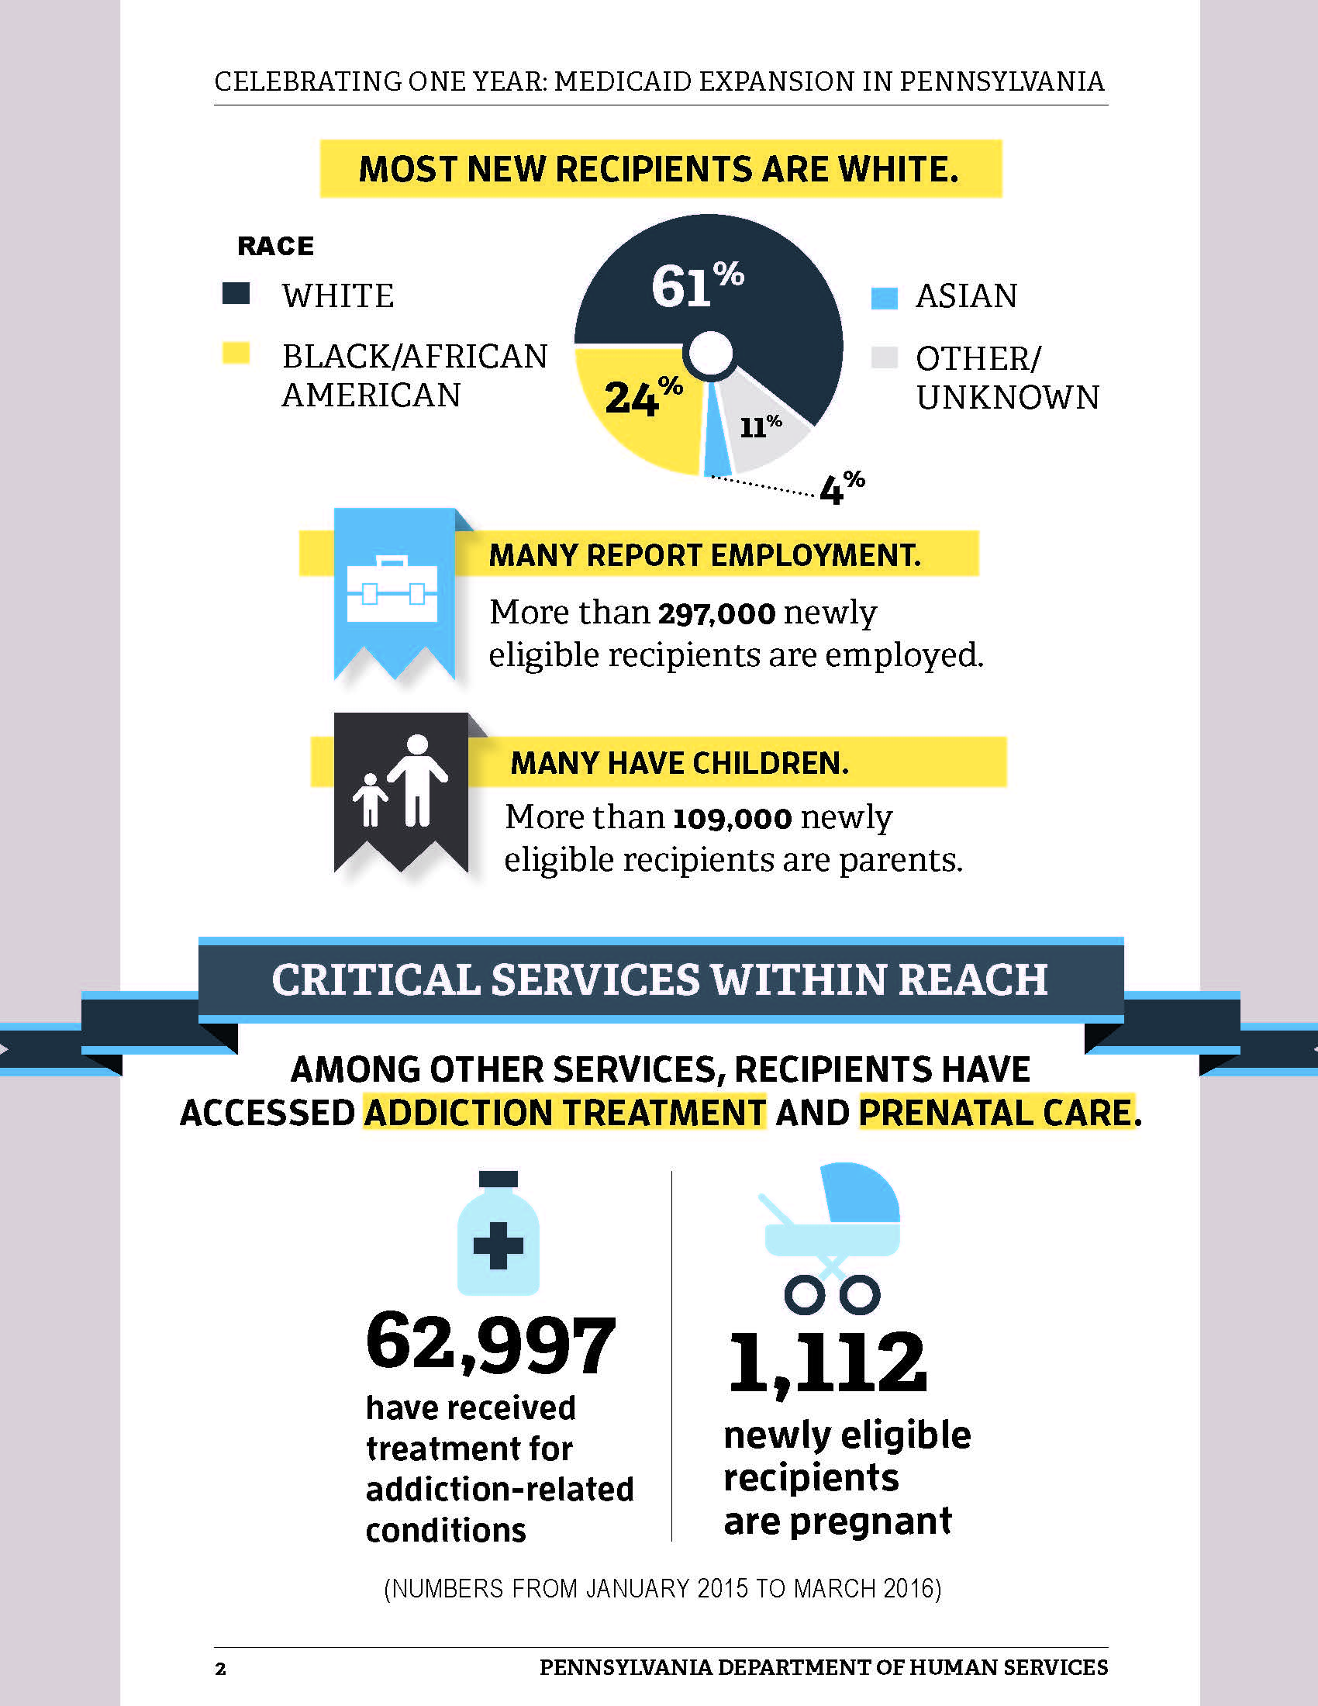
Medicaid Expansion

Slide 6
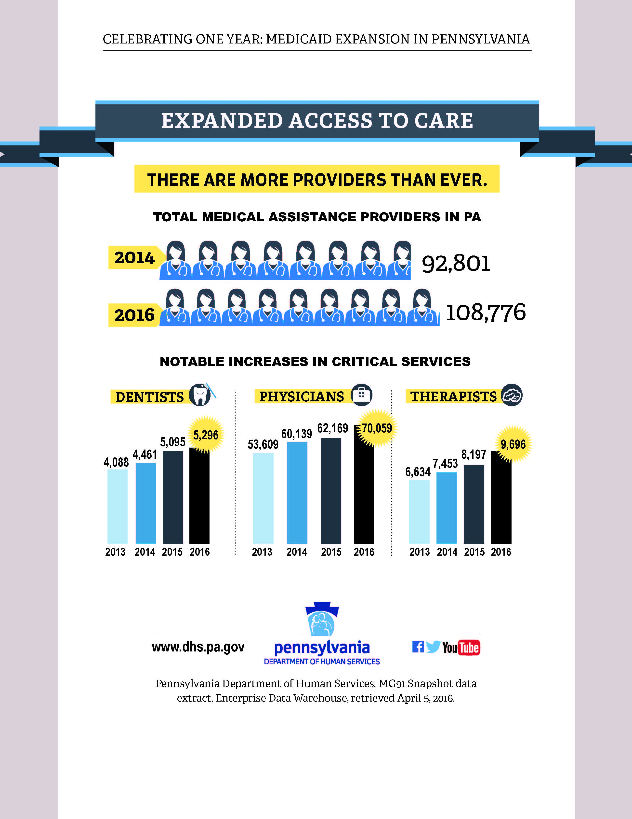
Medicaid Expansion

Slide 7
Provider Enrollment and Revalidation
Provider Revalidation
The Affordable Care Act requires Medicaid providers to revalidate at least every five years.
Providers that enrolled on or before September 25, 2011, need to submit their enrollment applications before July 30, 2016 to meet the September 25, 2016, NEW deadline.
As of May 06, 2016, DHS had revalidated 62% of all entities that need to be revalidated by September 25, 2016.
77% of FQHCs (provider type 08-080) have revalidated to date.
70% of Rural Health Clinics (provider type 08-081) have revalidated to date.
http://www.dhs.pa.gov/provider/promise/enrollmentinformation
for revalidation (enrollment) applications and a link to the electronic application
Notes:
77% of FQHCs (provider type 08-080) have revalidated to date.
Total 244 – 188 revalidated – 56 left to revalidate
70% of Rural Health Clinics (provider type 08-081) have revalidated to date.
Total 74 – 52 revalidated – 22 left to revalidate

Slide 8
Provider Enrollment and Revalidation
Provider Enrollment
Addressing the length of time it takes for a provider to be enrolled as a Medical Assistance provider
March 2015 - 162 day average to enroll provider
January 2016 - 32 day average to enroll provider
April 2016 - average time increased - 54 days due to application volume
Goal to enroll providers within 30 calendar days
Released an electronic provider enrollment application
Improves the submission for providers
Automates some of the processes that were manual in validating the application requirements

Slide 9
Shared Space (SOP) and Attestation
In an effort to support a more integrated approach to healthcare, DHS will be rescinding the “shared space” regulation at 55 Pa.Code§1101.51(c)(3).
Until then, DHS is issuing a Statement of Policy (SOP) clarifying the term “within a provider’s office”, as it is used in that regulation, and issuing a Medical Assistance (MA) bulletin describing the enrollment process for co-locating providers.
To streamline the enrollment process, co-locating providers will simply complete a form attesting to compliance with the provisions of 55 Pa.Code§1101.51 and submit signage that advises beneficiaries of their right to choose any MA enrolled provider.
The SOP will be published in the Pennsylvania Bulletin on May 28th, with the MA bulletin issued on the following Monday.

Slide 10
HealthChoices Procurement
Timeline
The RFP was issued on September 15, 2015 for a statewide procurement of the program.
Managed care organizations could bid on one zone, a combination of zones, or all zones.
Bids were due November 17, 2015 and DHS received the highest number of bids on record.
DHS received 11 proposals, several of which bid on the entire state.
On April 27 DHS announced its selection of eight MCOs to proceed with negotiations to deliver services in Pennsylvania beginning in 2017.
Negotiations will occur May 23 through June 3rd.
Readiness Review is in process.

Slide 11
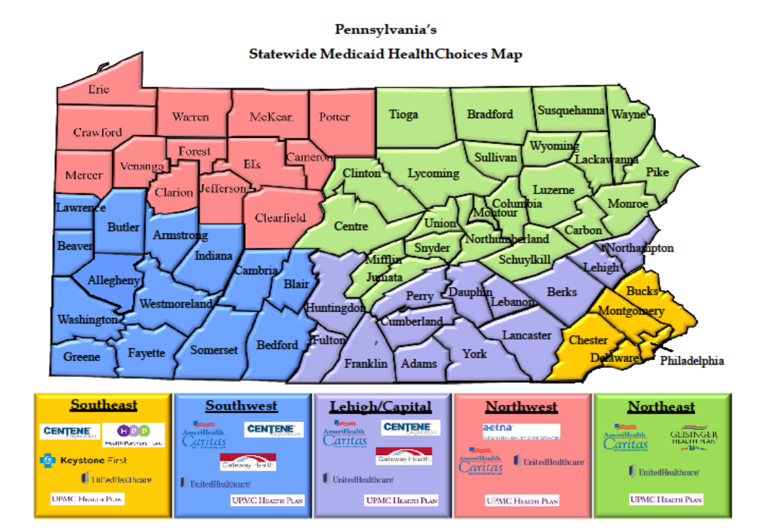
HealthChoices Procurement
Selections for Landmark Physical Health HealthChoices RFP
Notes:
Southeast Region
Centene (Pennsylvania Health and Wellness)
Health Partners Plans
United Healthcare of Pennsylvania, Inc.
UPMC for You, Inc.
Vista--Keystone First Health Plan
Lehigh/Capital Region
Centene (Pennsylvania Health and Wellness)
Gateway Health
United Healthcare of Pennsylvania, Inc.
UPMC for You
Vista—AmeriHealth Caritas Health Plan
Southwest Region
Centene (Pennsylvania Health and Wellness)
Gateway Health
United Healthcare of Pennsylvania, Inc.
UPMC for You
Vista—AmeriHealth Caritas Health Plan
Northwest Region
Aetna Better Health of Pennsylvania
United Healthcare of Pennsylvania, Inc.
UPMC for You
Vista—AmeriHealth Caritas Health Plan
Northeast Region
Geisinger Health Plan
United Healthcare of Pennsylvania, Inc.
UPMC for You
Vista—AmeriHealth Caritas
Health Plan

Slide 12
HealthChoices Procurement
Key Areas of Focus
Value Based Payment Targets
Other performance-based payments
Patient-centered medical homes
Bundled payments (increases value-based purchasing)
Accountable care organizations (voluntary networks of hospitals, doctors, and other providers that work together to provide coordinated care to patients)
Data Sharing
Among PH & BH – Managed Care Organizations
With Network Providers
Better Care Coordination & Integration
Integrated Care program for individuals with serious persistent mental illness
Opioid Use Disorder Centers of Excellence

Slide 13
Partnering with Community Health Centers
Financial Reporting Changes
Wrap Around Modernization
Faster Payment Processing
Better Focus on Financial Customer Service
Modernized Cost Reports
Notes:
As you may be aware, DHS worked quickly to address a much-needed change in wrap around reporting process by adding new/additional resources and modernizing the reporting process. This has resulted in a reduction of backlogged reports and for the health centers greater reliability for payment.
We continue to update our internal review process. Prior to the Wrap around modernization payments were not processed until 45 days post report submission, at the earliest. With our new process, payments are being processed within 30 days and in some cases, we have been able to make payment within that 30-day period.
I’m sure you are all aware of the focus the financial staff are now placing on customer service. We have assigned a unit of three staff to be focused on all financial aspects of the FQHC prospective payment system (PPS) rate program. This provides health centers with a single point of contact for questions or concerns to DHS and helps us to provide timely follow-up.
DHS recognizes a need to modernize cost reports. DHS is currently working to develop a more modern cost report that will reduce the complexity in the current reporting template.

Slide 14
On the Horizon
Impact of the Federal Medicaid Managed Care Regulation
Implementation of the Managed Care Agreements
Announcement of the Community HealthChoices Vendors & Next Steps

Slide 15
?

Slide 16
Pennsylvania Association of
Community Health Centers
2016 Meeting & Legislative Day
May 17, 2016
Leesa Allen
Deputy Secretary
Office of Medical Assistance Programs

